Slide 1

LA ESPERADA PESCA Isabella Hernández O 16 / Marzo / 2020

Slide 2
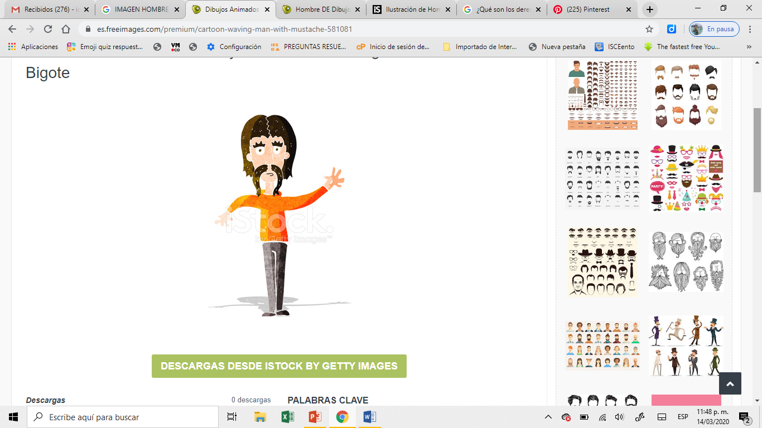
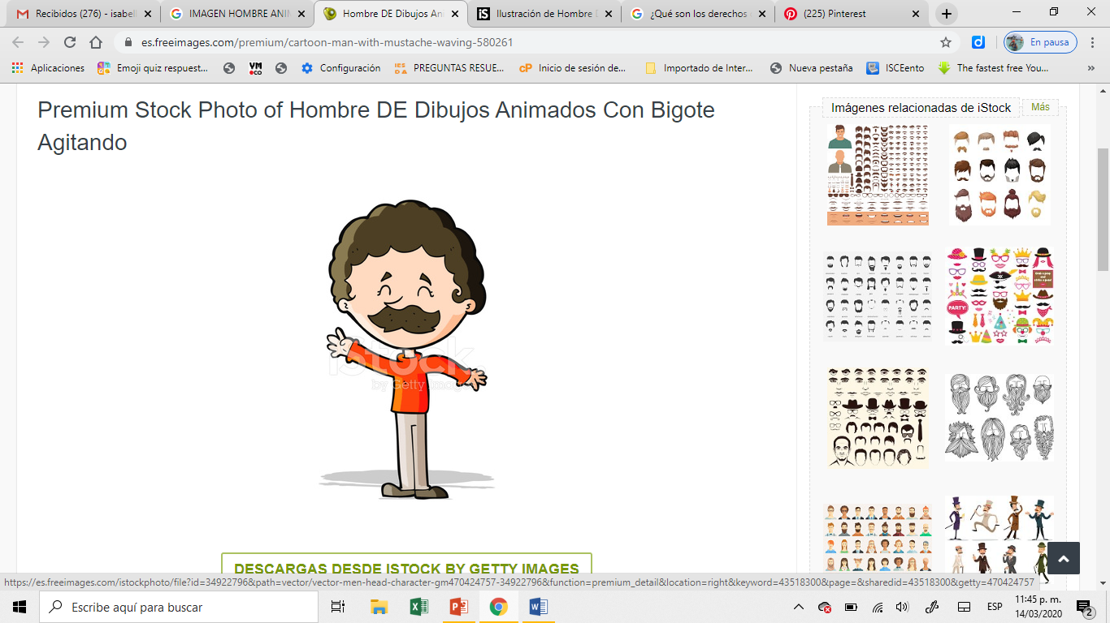
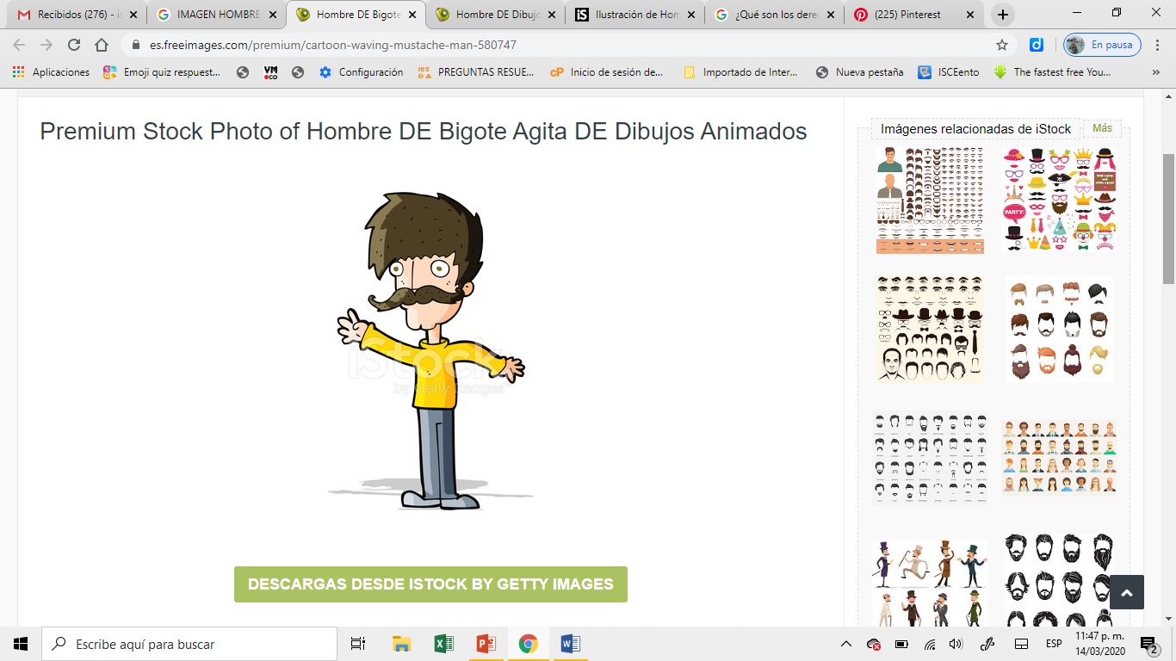
PABLO
PEDRO
MARTIN

Slide 3
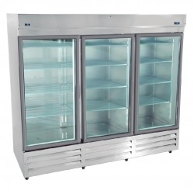


Slide 4
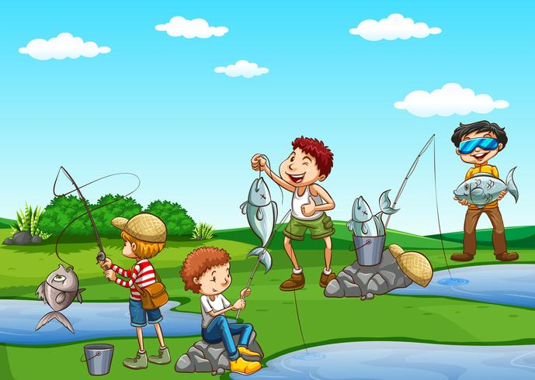
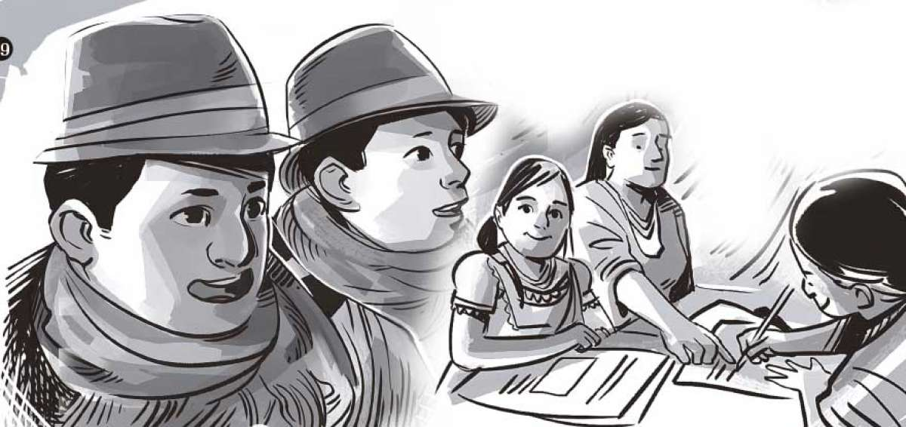


Slide 5


Slide 6
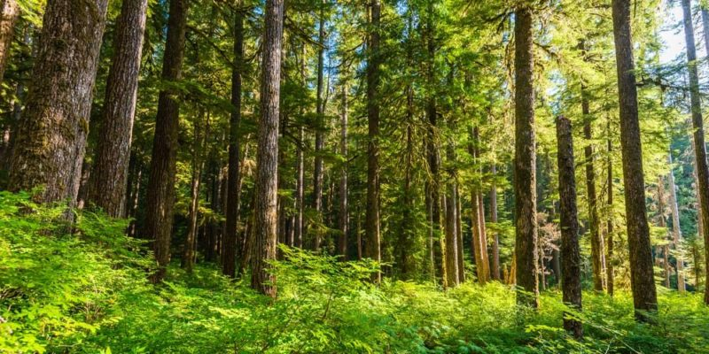


Slide 7
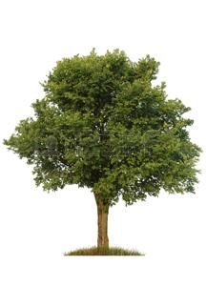



Slide 8


Slide 9


FE
PERSEVERANCIA

Slide 10
PABLO
MARTIN
PEDRO

Slide 11
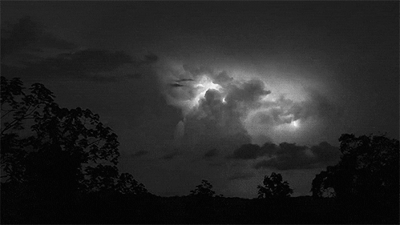

Slide 12
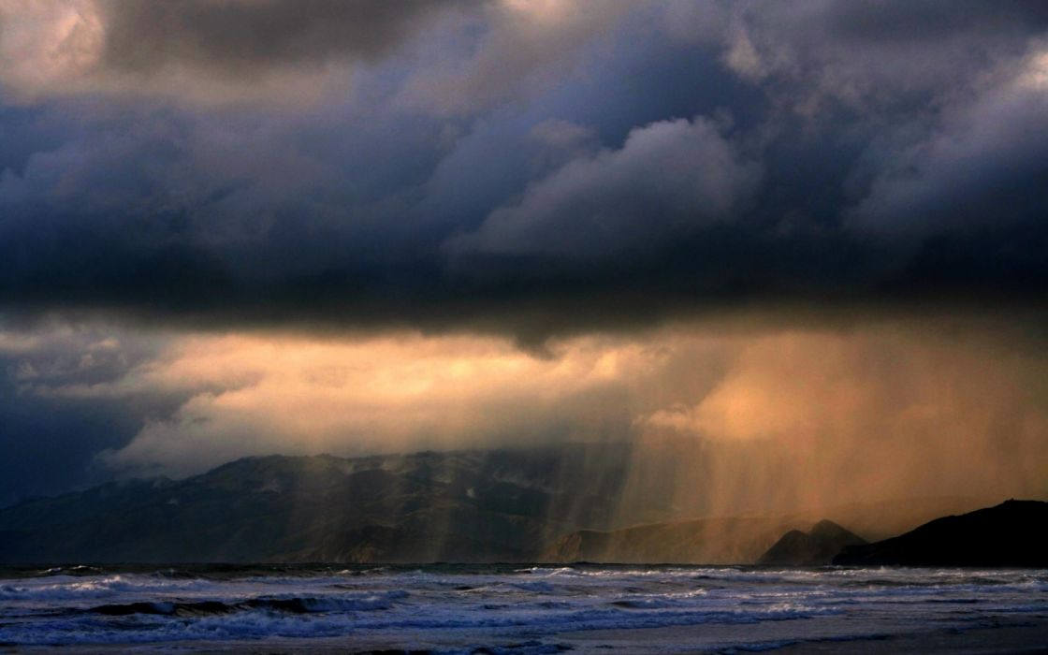

Slide 13
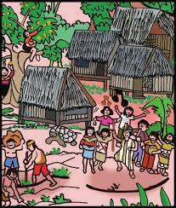

Slide 14




Slide 15


Slide 16
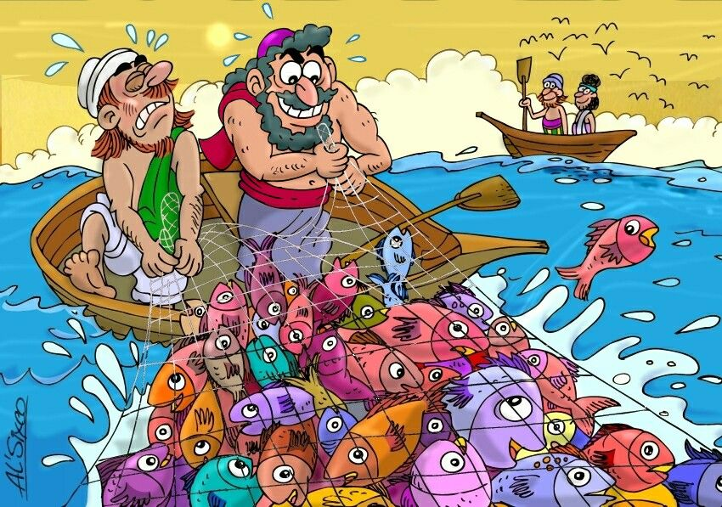

Slide 17
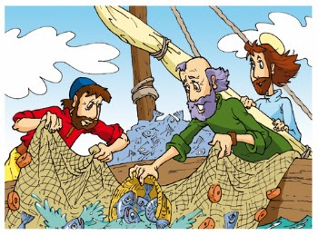

Slide 18
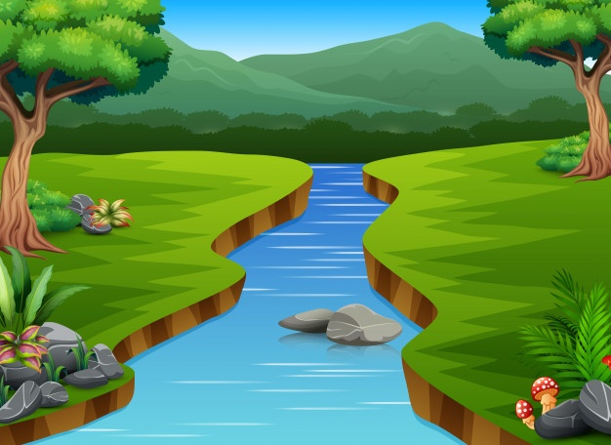

Slide 19

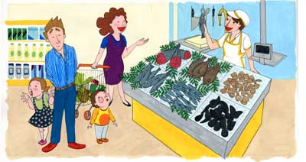

Slide 20
F E
P E R S E V E R A N C I A

Slide 21
F I N

Slide 22
REFERENCIAS
https://png.pngtree.com/png-clipart/20190611/original/pngtree-thinking-png-image_2273162.jpg
https://co.pinterest.com/pin/575334921131808521/
https://static.vecteezy.com/system/resources/previews/000/294/190/non_2x/vector-group-of-boys-fishing.jpg
https://www.eltelegrafo.com.ec/media/k2/items/cache/60ce4b6d024043582856bb50cf9dfa55_XL.jpg
https://2.bp.blogspot.com/-WpXSdGAZKVI/ViWAuPPgY-I/AAAAAAAAAJA/DCIO64sjif4/s1600/descarga.png
https://previews.123rf.com/images/topvectors/topvectors1610/topvectors161000150/63842748-barco-de-madera-con-agua-de-mar-azul-en-el-fondo-vacaciones-playa-relacionados-con-la-ilustraci%C3%B3n-dibuj.jpg

Slide 23
https://i.pinimg.com/originals/d1/e5/fb/d1e5fbf2f22525140492c1f54afaff92.png
https://st2.depositphotos.com/2172759/7628/v/450/depositphotos_76281439-stock-illustration-cartoon-face-isolated-on-white.jpg
https://www.wallpaperup.com/uploads/wallpapers/2017/12/21/1173322/f8cf3511d2f079b54649e8a74314a8a9-700.jpg
https://encrypted-tbn0.gstatic.com/images?q=tbn%3AANd9GcTu7jAfRpezhLetaYSLMrwWbPPKBpnzaIudrl-ieEbnlb9CnLOK
https://media0.giphy.com/media/voXTb5vcbHfnq/giphy.gif
https://i.pinimg.com/originals/2b/f5/8c/2bf58c59e0e04faa51018cee6238ec75.png

Slide 24
https://www.freepng.es/png-bfc5pd/download.html
https://img.freepik.com/vector-gratis/dibujos-animados-rio-medio-hermoso-paisaje-natural_43633-5901.jpg?size=626&ext=jpg
https://media2.giphy.com/media/QuGHBsYciDZzG/giphy.gif
https://www.dibujosyjuegos.com/dibujos/galleries/Historia/indios/dibujos-de-indios-071.gif
https://i0.pngocean.com/files/990/748/880/rowing-boat-evezu0151s-csxf3nak-clip-art-a-boat.jpg
https://images.emojiterra.com/mozilla/512px/1f5e3.png

